Slide 1
Routing Tenure track promotions Via Infoporte

Slide 2
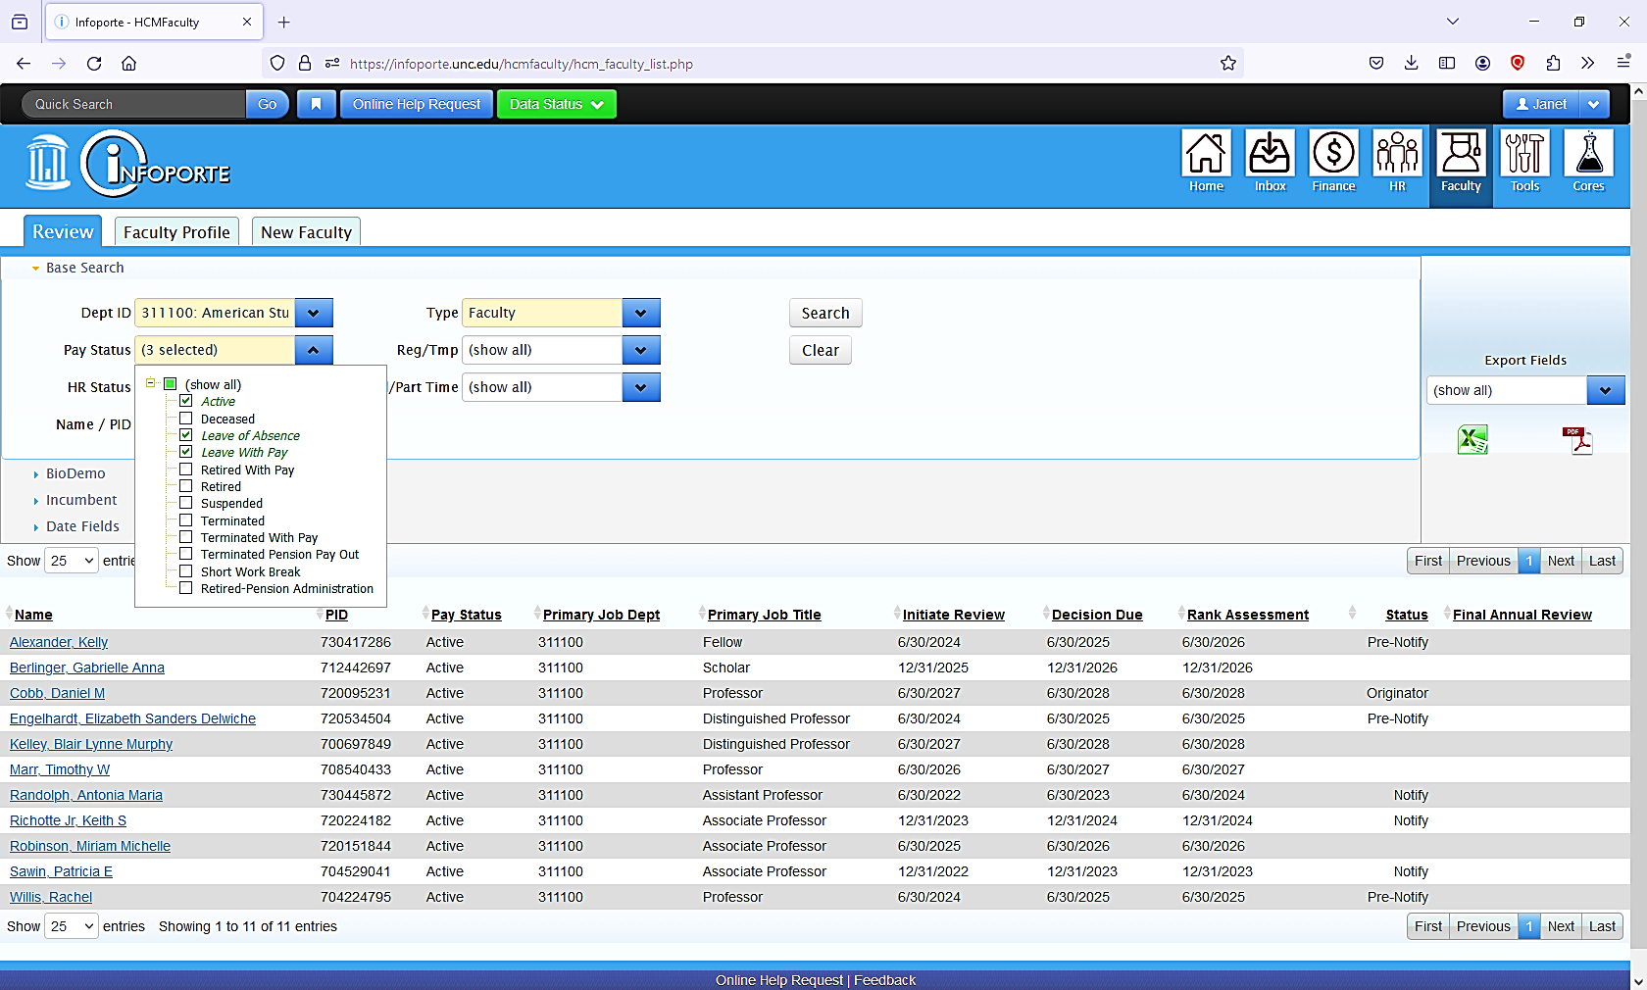
Click Faculty Tab
Select three categories (Active, Leave with pay and leave without pay
John Doe
Mary Smith
Oscar Brooks
Ann Jones
Trudy Parton
Elvira Oakridge
Jamie Brewer
Jane Doe
Louise Thomas
Elizabeth Miller
00000000
000000000000000000000000000000000000000000000000000000000000000000000000
Click on faculty name to bring up request

Slide 3
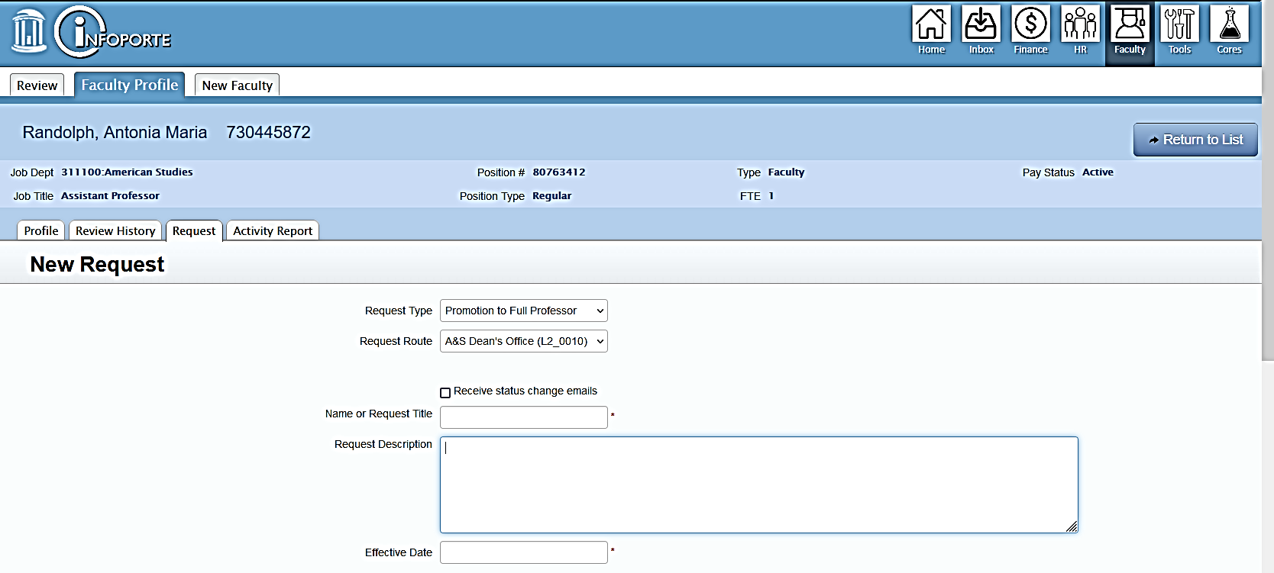
Jane Doe 000000000
Click Request
Select Promotion Type (full professor or associate professor)
Route Type: A&S Dean’s Office
Insert Faculty Name
Description of action
Select current date from dropdown calendar

Slide 4
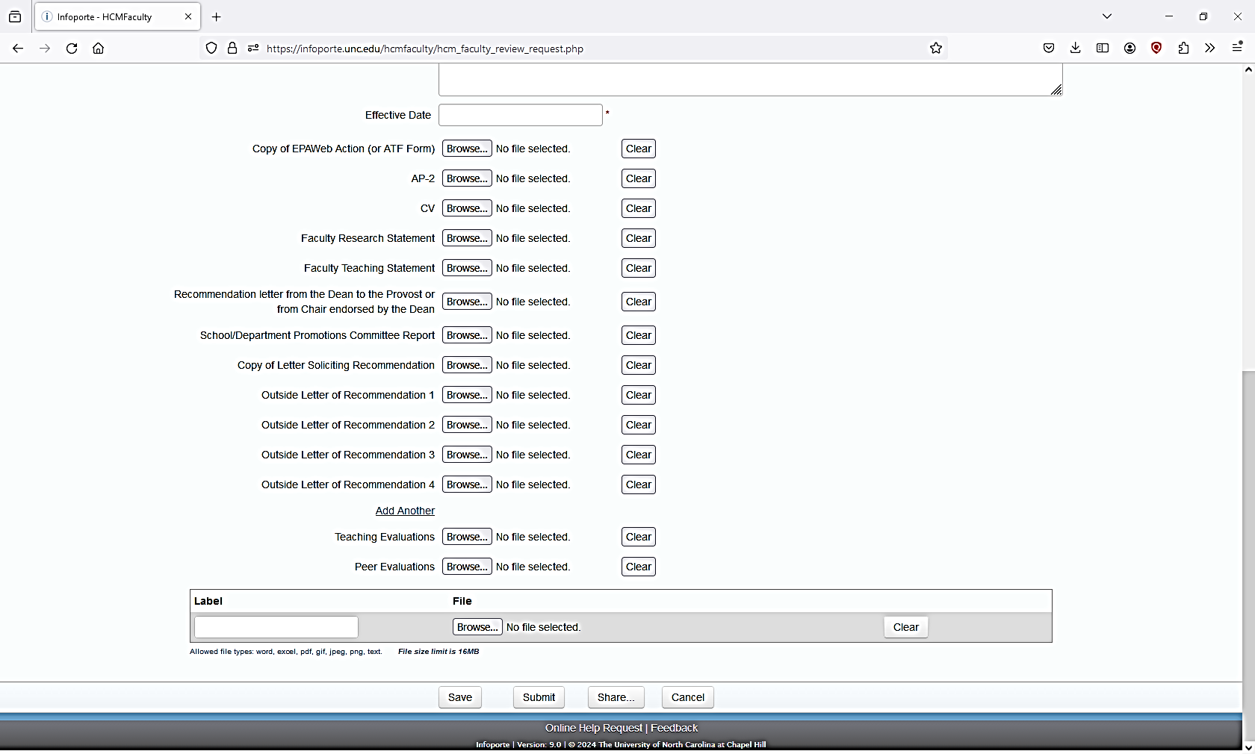
Upload Documents in PDF format
EPA web no longer needed
Upload Additional Documents Here
Submit to move file to Teresa/Janet Inbox

