Slide 1
Routing Teaching Track Promotions
VIA INFOPORTE

Slide 2
Click on Faculty
Click Incumbent
Uncheck tenured ranks – check those highlighted here

Slide 3
Click on Name of faculty member you want to submit the promotion for
John Doe
Jane Smith
Oscar Jones
Nancy Brooks
Thomas Woods
Jane Doe
Mary Lamb
0000000000
0000000000
0000000000
0000000000
0000000000
0000000000
0000000000

Slide 4
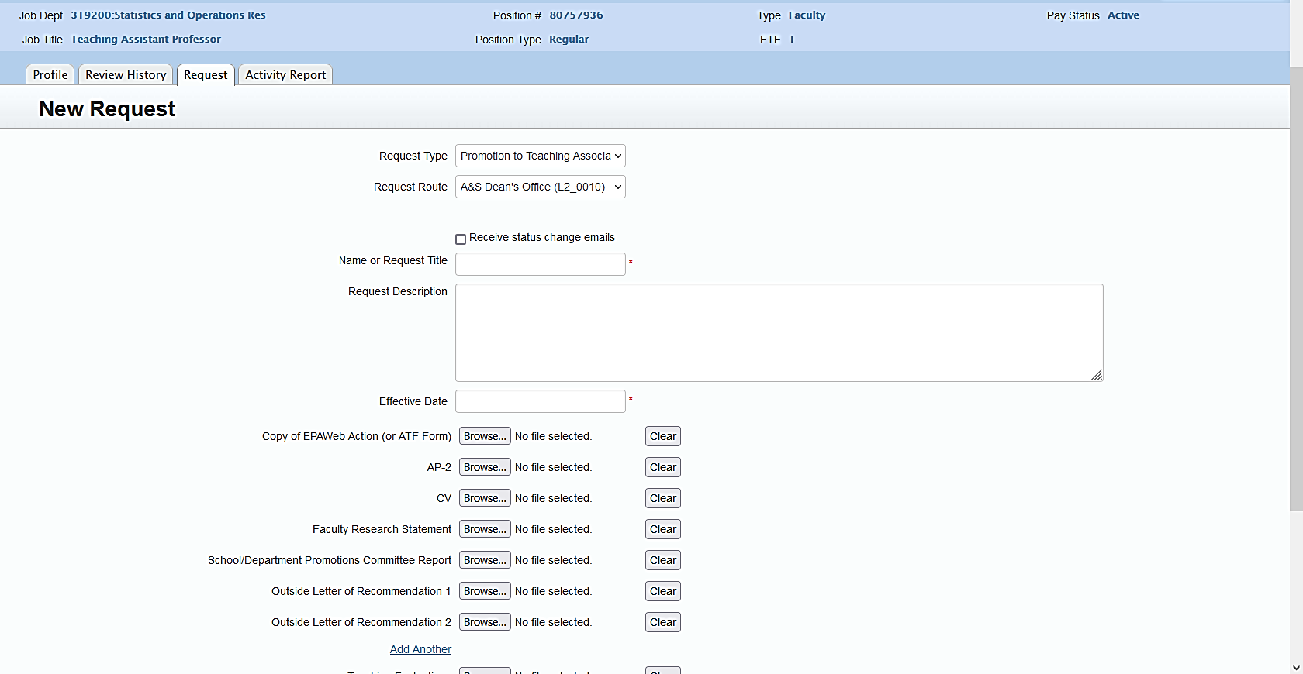
Select from dropdown
Insert Faculty Name
Add description of request
Use the dropdown calendar select date
Upload documents in PDF format

Slide 5
Finish Uploads
Here is where you upload any additional documents
Click submit to move to Teresa/Janet Inbox

