Slide 1
Routing TT Faculty Hire Via Infoporte

Slide 2
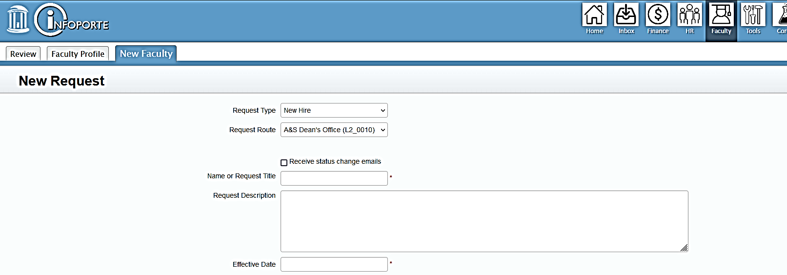
Select Request Type – New Hire
Request Route – A&S Dean’s Office (L2-0010)
Insert Candidate Name
Add brief description: 7/1/24 Asst Prof Hire
Select current date from dropdown

Slide 3
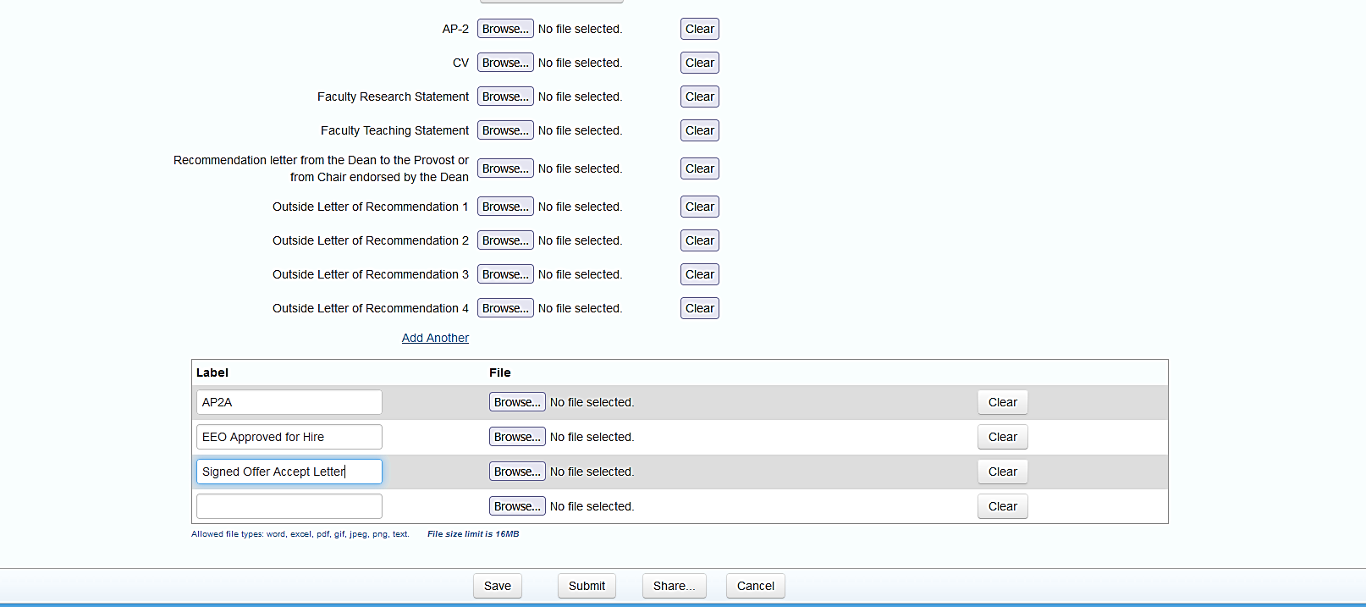
Upload required documents
Upload required documents
Upload required additional documents
Other Documents to Upload: AP2A
EEO Approved for Hire, Offer/Accept letter
Click to submit to Janet and Teresa

