Slide 1
Routing PTRs to the Dean’s Office
College of Arts & Sciences

Slide 2
Log in to Infoporte
http://Infoporte.unc.edu
Log in with onyen and password
For access issues, contact the Access Request Coordinator
Find out more at http://ccinfo.unc.edu/access/

Slide 3
Access the Faculty Tab
IMPORTANT: Make sure that you on the correct tab!

Slide 4
Choose the Employee
John Smith
Jane Smith
Peter Smith
Pamela Smith
John Johnson
Jane Johnson
Jane Doe
John Doe
Jane Williams
Pamela Williams
John Williams
John Jones
Jane Jones
Jack Jones
Jackie Jones
Pamela Jones

Slide 5
Access the Request Tab
Jane Doe 71234567

Slide 6
Choose the Request Type
Choose Post Tenure Review

Slide 7
Choose the Request Route
Choose the appropriate route for your division. The route should be named [Div] PTR Submission to SAD.

Slide 8
Name the Request
Use the person’s full name followed by PTR
Jane Doe

Slide 9
Upload Appropriate Files

Slide 10
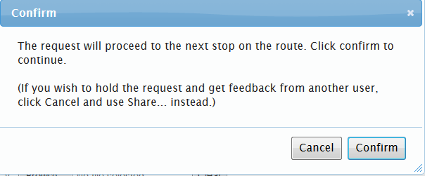
Submit the Request

Slide 11
Additional Information
The request will route directly to the Senior Associate Dean when you click submit.
After the Senior Associate Dean concludes the review or requests additional information to complete the approval, the request routes directly to the Dean’s Office HR (Janet Farrell and Teresa Wilkinson).
This request will be visible in the originator’s Inbox, like other Infoporte requests.
Make sure that you choose the appropriate route.

Slide 12
Questions
Questions should be directed to:
PTR Questions
Janet Farrell, janet_Farrell@unc.edu
Teresa Wilkinson, tsmith7@email.unc.edu
Ashante Diallo, Ashante@unc.edu
Infoporte/Routing Questions
Joy Montemorano, jmonte@email.unc.edu

